Slide 1

Module 3
Dimension Reduction
Notes:
Guidelines
Use section headers to chunk content in your presentation.
Use the same style of section header throughout your presentation.
Keep your title to no more than 2 lines.

Slide 2

The Curse of Dimensionality
Notes:
Guidelines
Use a title slide at the beginning of your presentation. There are 9 variations of title slides to choose from.
If you will have a series of slideshows, we recommend using the same style of title slide for each presentation.
Keep your title to no more than 2 lines.
Do not change the font style or font size of the title or subtitle.

Slide 3
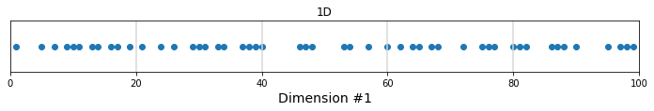
The Curse of Dimensionality
E.g., we generate 50 observations uniformly from 1 to 100 for 1 variable x1
Dividing x1 into 6 equal spaces we get on average 50/5 = 10 points per space.
If we need to perform an estimation in any of these spaces, the observations are low but enough to get some metrics.

Slide 4
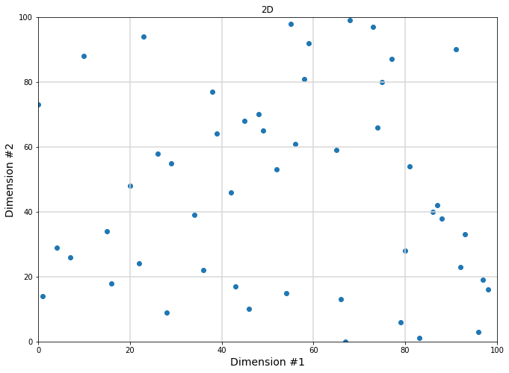
The Curse of Dimensionality
Adding another dimension with the same characteristics, that is, we generate 50 observations uniformly from 1 to 100 for variable x1 and for x2

Slide 5
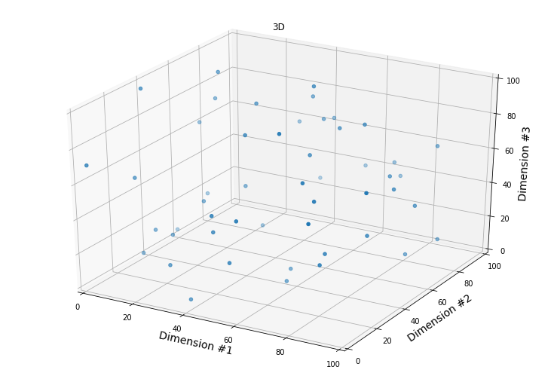
The Curse of Dimensionality
Adding another dimension for a total of 3 with the same characteristics, that is, we generate 50 observations uniformly from 1 to 100 for variable x1, for x2, and x3

Slide 6
Consideration to Remove Variables
Timing
Cost
Irrelevant Variables

Slide 7
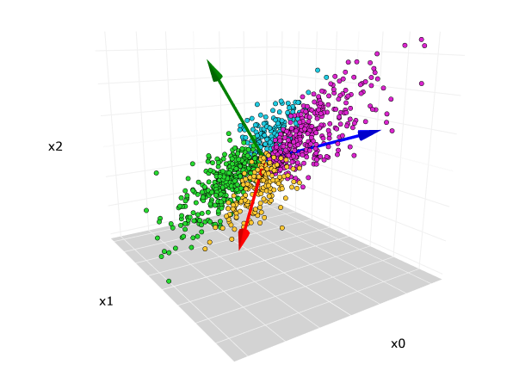
Complexity: Model Degrees of Freedom
For linear models (logistic/linear regression)
Categorical variables: # levels – 1 model df
Numeric variables: 1 model df

Slide 8
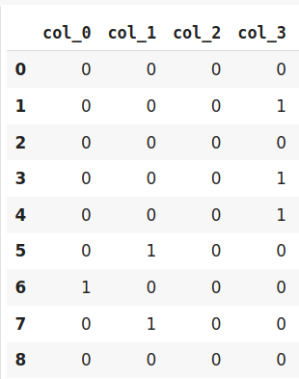
Do not Remove Important Variables

